Slide 1

Dexterity Check
Apmae4990: Introduction to data science
spring 2018

Slide 2
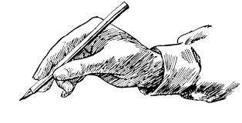
What is dexterity check?
Dexterity check is a tool that measures hand motor function by asking the subject to submit drawings of a ‘circle’ ‘triangle’ ‘heart’ and ‘star’
Then four different algorithms are used to determine what shape you drew
Your performance is measured simply as “scores” of the number of correctly identified shapes.

Slide 3
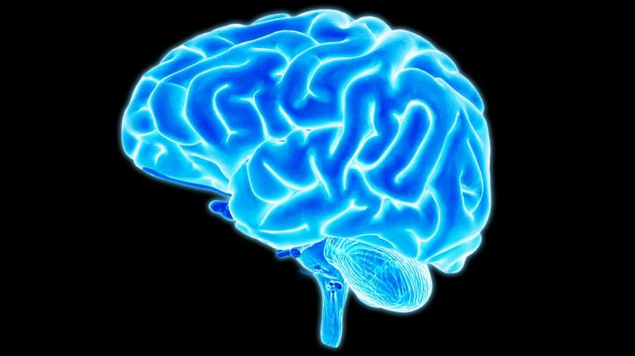
MOTIVATION
Every year approximately 800,000 people suffer from stroke which causes impairment of upper extremity functioning
Reaching and grasping studies are performed to study hand and arm impairment
Movement disorders are usually diagnosed with a neurological exam, MRI scan, or an electromyography.

Slide 4
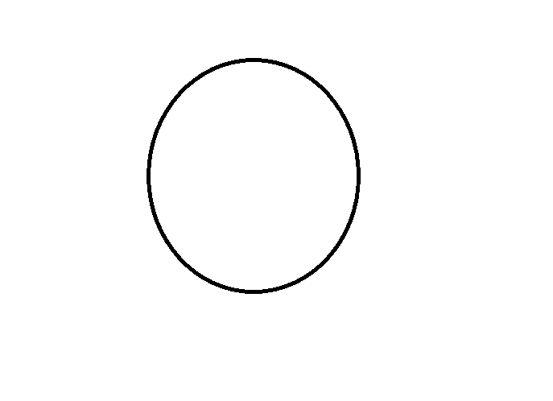
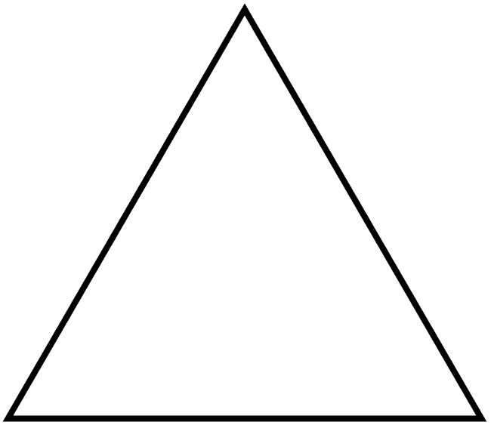


THE Shapes

Slide 5
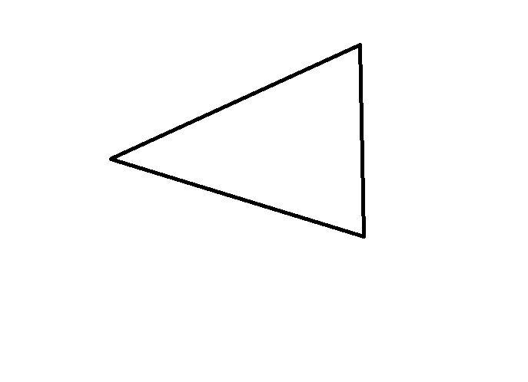
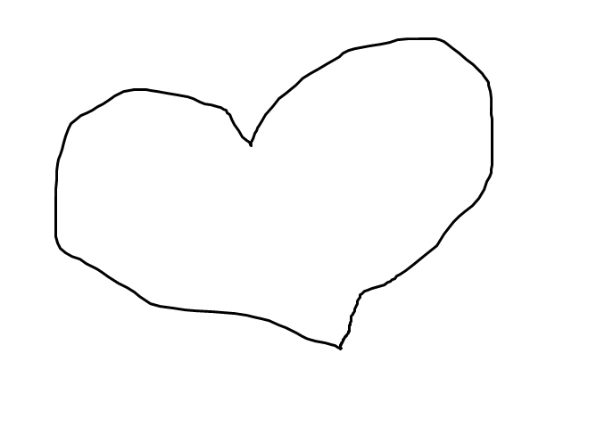

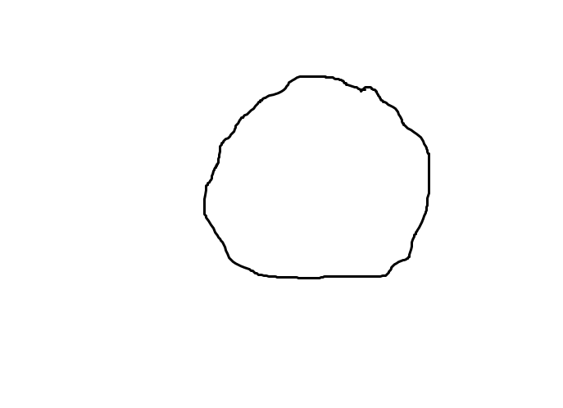
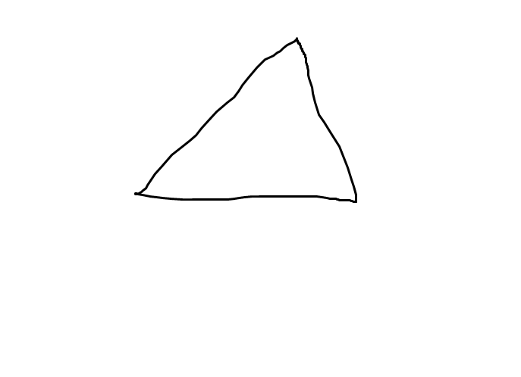
SUPERVISED PROBLEM: MIXED TRAINING SET

Slide 6
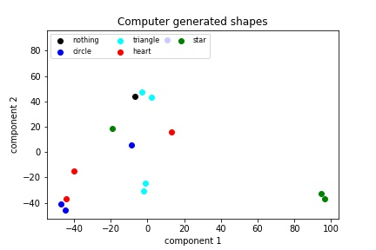
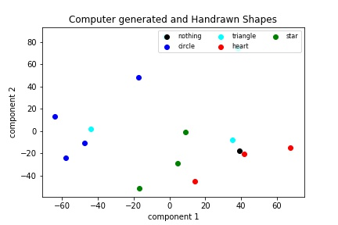
PCA COMPARISON of mixed TRAINING SET versus computer generated only
Computer Generated Only data set
Computer Generated and Hand drawn data set (Mixed)

Slide 7
Flowchart
Upload Images
Preprocessing: Regularization of data, Standardize data, resize images, reshape data
PCA
KNN
LOGISTIC REGRESSION
SVM
Assign score
Assign score
Assign score

Slide 8
MULTI CLASS CLASSIFICATION METHODS:
80% training set 20% test set WITH RANDOMIZATION
GRIDSEARCH CV TO FIND OPTIMAL ‘K’ or ‘ALPHA’ with cv=5
L2 regularization for higher accuracy
CONFUSION MATRIX to validate model
METHODS
K nearest neighbor
LOGISTIC REGRESSION
SUPPORT VECTOR MACHINE (LINEAR KERNEL)
SUPPORT VECTOR MACHINE AFTER PCA

Slide 9
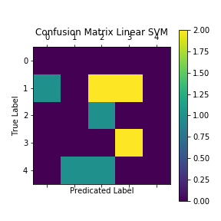
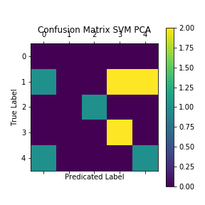
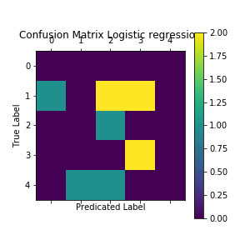
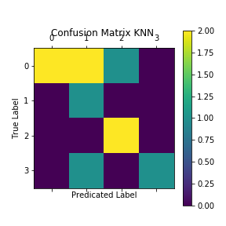
MODEL PERFORMANCE: THE CONFUSION MATRIX
SVM AFTER PCA
LOGISTIC REGRESSION
SVM
KNN

Slide 10
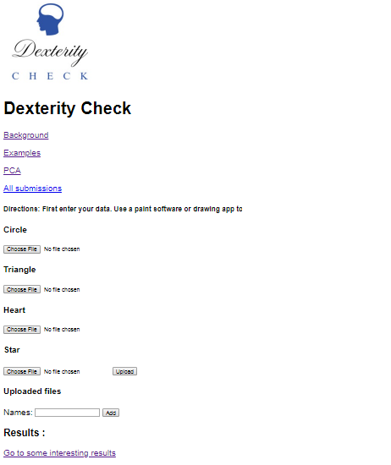
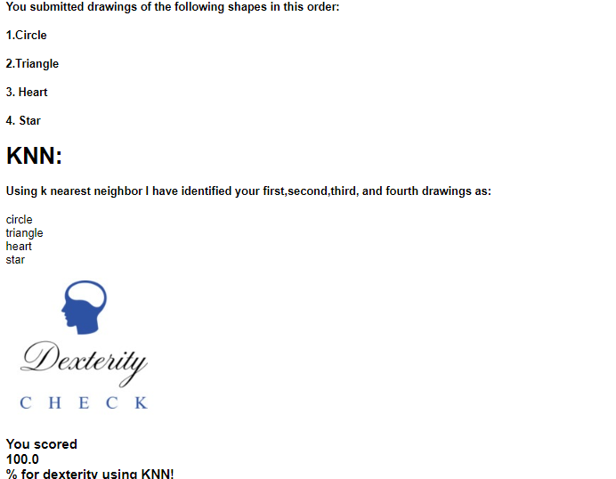
Dexterity check TOOL

